Slide 1



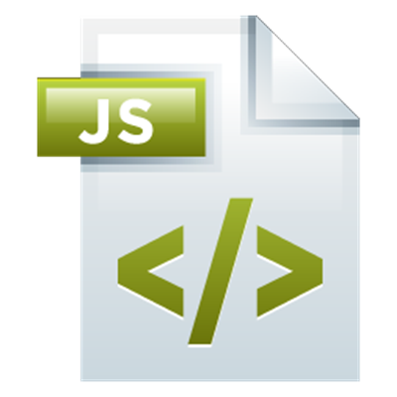

JavaScript Syntax
Syntax, Conditions, Loops, Functions, Objects, Arrays
JavaScript for Front-End
SoftUni Team
Technical Trainers
Software University
http://softuni.bg

Slide 2
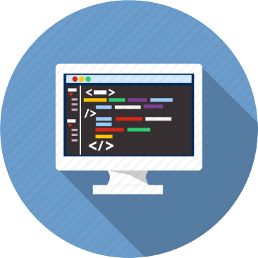


Table of Contents
JavaScript Introduction
Variables and Operators
Conditions: if-else, switch
Loops: for, while, do-while, …
Functions
Objects
Arrays
Strings

Slide 3
Have a Question?
sli.do #front-end

Slide 4
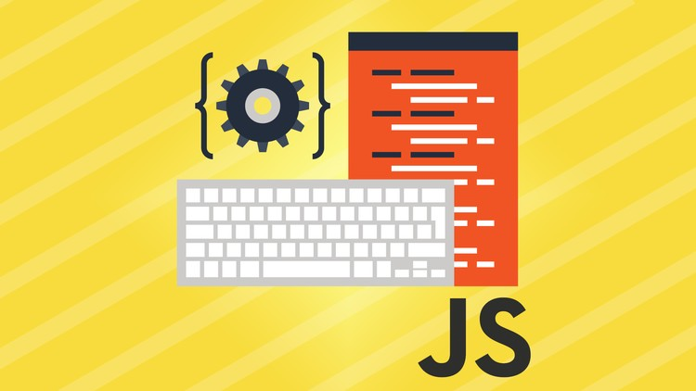
JavaScript Introduction
Syntax and Comparison

Slide 5
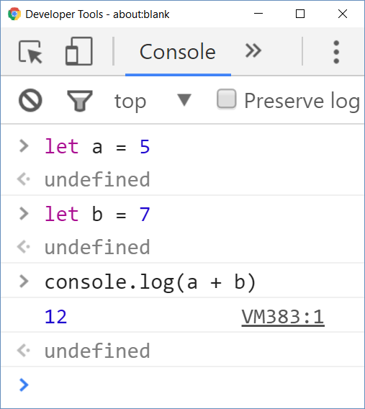
Welcome to JavaScript
JavaScript (JS) is a scripting language
Executes commands (script)
Can work in interactive mode
No compilation, just execute commands
C# / Java are statically-typed languages
Programs are first compiled
Then the compiled binary is executed

Slide 6
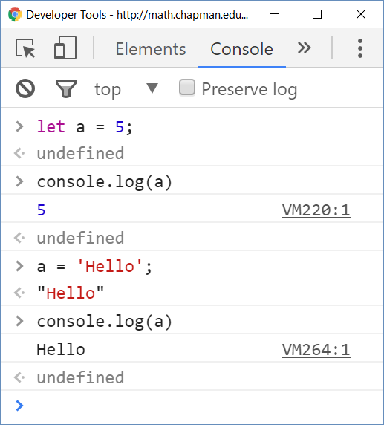
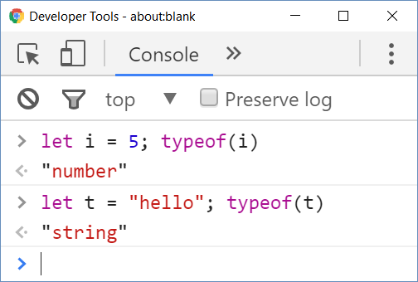
Welcome to JavaScript (2)
JavaScript (JS) is untyped language
Untyped (dynamically typed) == variables have no types
Data (values) still have a type

Slide 7
Variables and Operators in JS
Define variables with the keyword let
let i = 5; let j = 3; // i and j are numbers
console.log(typeof(i)) // Number
i = i * j; i++; // 16
console.log(i + 1); // 17
The ; can be omitted
let str = 'Hello'; // string
str = str + " JS";
console.log(str); // Hello JS
Strings are in format '…' or "…"
Undefined identifier usage
console.log(s2); // Uncaught ReferenceError: s2 is not defined

Slide 8
Problem: Calculate Expression
Write a JavaScript program to print the value of the following expression: (30 + 25) + ((35 – 14) * 2)
Sample solution:
function solve() {
let val = (30 + 25) + ((35 – 14) * 2);
console.log(val);
}

Slide 9
Type Conversions
All JS types can be compared due to automatic type conversion
More examples to play with:
WAT, JS Weird Parts
5 == "5.0" // true (== checks value)
5 === "5.0" // false (=== checks type + value)
1 == true // true
[] == false // true
'' == false // true
"" == 0 // true
5 + false + true === 6 // true

Slide 10
Conditions: if-else
JavaScript implements the classical if / if-else statements:
let number = 5;
if (number % 2 == 0) {
console.log("Even number");
} else {
console.log("Odd number");
}

Slide 11
Problem: Bigger Number
Write a JavaScript program to print bigger of two numbers:
let firstNumber;
let secondNumber;
Sample solution:
let firstNumber = 100;
let secondNumber = 200;

Slide 12
Solution: Bigger Number
function solve(input) {
let firstNumber = Number(input[0]);
let secondNumber = Number(input[1]);
if (firstNumber > secondNumber) {
console.log(firstNumber);
} else {
console.log(secondNumber);
}
}

Slide 13
The switch-case Statement
Selects a statement from a list depending on the value of the switch expression
let day = 3
switch (day) {
case 1: console.log('Monday'); break;
case 2: console.log('Tuesday'); break;
case 3: console.log('Wednesday'); break;
…
case 7: console.log('Sunday'); break;
default: console.log('Error!'); break;
}

Slide 14
Loops: for, while, do-while, …
The for / while / do-while loops work as in C# and Java
for (let i = 0; i <= 10; i++)
console.log(i); // 0 1 2 3 4 … 10
let count = 1;
while (count < 1024)
console.log(count *= 2); // 2 4 8 16 … 1024
let s = "ha“;
do { console.log(s); s = s + s; }
while (s.length < 10); // ha haha hahahaha

Slide 15
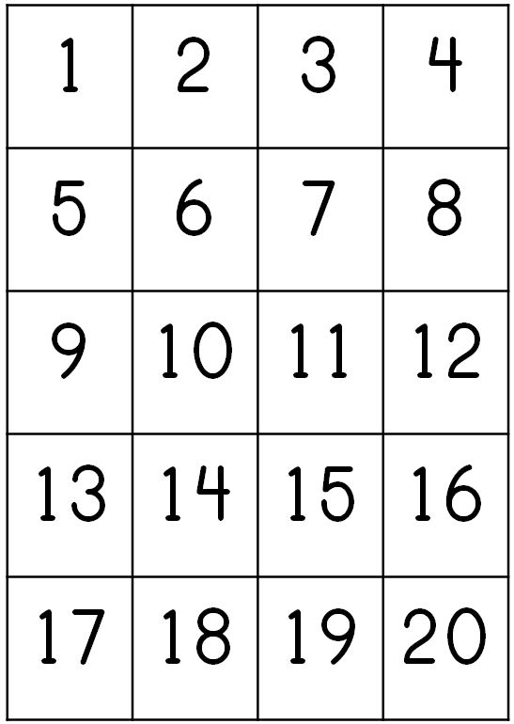

Problem: Print first 20 numbers
Write a JavaScript program to print first 20 numbers:
Use for, while or do-while loop:

Slide 16
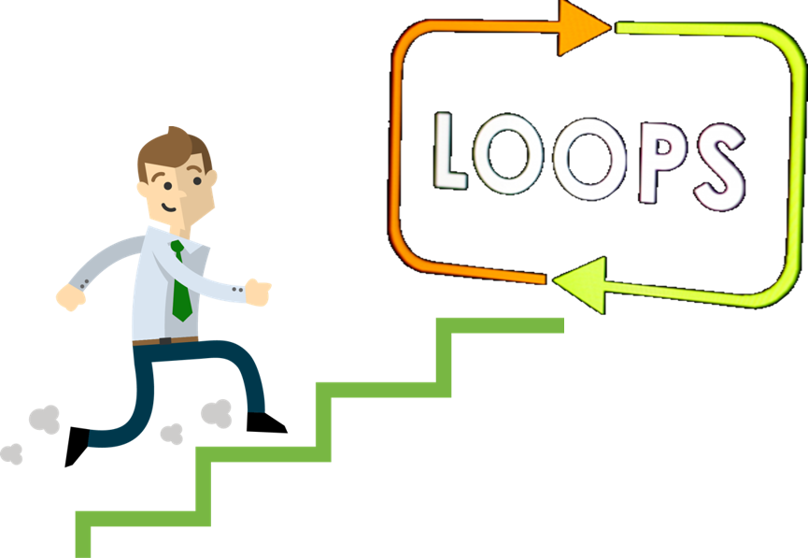
Solution: First 20 Numbers
It’s so simple:
function solve() {
for (let i = 1; i <= 20; i++) {
console.log(i);
}
}

Slide 17
Functions
Functions in JS hold a piece of code (script)
Can take parameters and return result
Similar to functions in C and PHP and methods in C++ / C# / Java
function multiply(a, b) {
return a * b;
}
console.log(multiply(2, 3)); // 6 == 2 * 3
console.log(multiply(2)); // NaN == 2 * undefined
console.log(multiply(5, 6, 7)); // 30 == 5 * 6

Slide 18
Anonymous Functions and Callbacks
let print = function(x) { console.log(x) };
[10, 20, 30].forEach(print) // 10 20 30
let sum = 0;
[10, 20, 30].forEach(function(x) {
sum += x;
});
console.log(sum) // 60
(function(text) { alert(text) })("hello")

Slide 19
Block Scope vs. Function Scope
var defines "function scope"
Use var carefully!
(function functionScope() {
console.log(x); // undefined
for (var x = 1; x < 10; x++)
console.log(x);; // 1 … 9
console.log(x); // 10
var x = 5; console.log(x); // 5
var x = 2; console.log(x); // 2
x = 3; console.log(x) // 3
}) ();

Slide 20
Block Scope vs. Function Scope (2)
let defines "block scope"
Prefer let in most cases
(function blockScope() {
// console.log(x); // error!
let x = 5; console.log(x); // 5
for (let x = 20; x < 30; x++)
console.log(x); // 20 … 29
console.log(x); // 5
x = 10; console.log(x); // 10
// let x = 5; // error!
}) ();

Slide 21
Objects
Objects in JavaScript hold key-value pairs:
let obj = { name : "SoftUni", age : 2 };
console.log(obj); // Object {name: "SoftUni", age: 2}
obj['site'] = "http://www.softuni.bg";
obj.age = 10;
obj['name'] = "Software University";
console.log(obj); // Object {name: "Software University", age: 10, site: "http://www.softuni.bg"}
delete obj.name;
delete obj.site;
console.log(obj); // Object {age: 10}

Slide 22


Objects and JSON
JavaScript objects can be stored as text in JSON format
let obj = { name : "SoftUni", age : 2 }
let str = JSON.stringify(obj);
console.log(str);
// { "name":"SoftUni", "age":2 }
let str = "{\"name\":\"Nakov\",\"age\":24}"
let obj = JSON.parse(str);
console.log(obj); //
Object { name: "Nakov", age: 24 }

Slide 23
Arrays in JavaScript
Arrays in JS can hold mixed types:
// Array holding numbers
let numbers = [1, 2, 3, 4, 5];
// Array holding strings
let weekDays = ['Monday', 'Tuesday', 'Wednesday',
'Thursday', 'Friday', 'Saturday', 'Sunday'];
// Array of mixed data
var mixedArr = [1, new Date(), 'hello'];

Slide 24

Problem: Print the elements in array
Write a JavaScript program to print all of the elements in array:
Create random array like this:
Put your solution in function
let numbers = [1, 2, 3, 4, 5];

Slide 25
Solution: Print the elements in array
function solve(input) {
for (let element of array) {
console.log(element);
}
}
function solve(input) {
for (let index in array) {
console.log(array[index]);
}
}

Slide 26
Processing Arrays Elements
Print all elements of an array of strings:
let capitals = ['Sofia', 'Washington', 'London', 'Paris'];
for (let capital of capitals)
console.log(capital);
for (let i in capitals)
console.log(capitals[i]);
for (let i = 0; i < capitals.length; i++)
console.log(capitals[i]);
Works like foreach
This is not foreach! It goes through the array indices.
Traditional for-loop

Slide 27
Array Operations
let numbers = [1, 2, 3, 4];
console.log(numbers.join('|')); // result: 1|2|3|4|5
numbers.push(5);
console.log(numbers.join('|')); // result: 1|2|3|4|5
let tail = numbers.pop(); // tail = 5;
console.log(numbers.join('|')); // result: 1|2|3|4
numbers.unshift(0);
console.log(numbers.join('|')); // result: 0|1|2|3|4
let head = numbers.shift(); // head = 0;
console.log(numbers.join('|')); // result: 1|2|3|4

Slide 28
Strings
Strings in JavaScript hold a sequence of Unicode characters
let str1 = "Some text in a string variable";
let str2 = 'Text enclosed in single quotes';
for (let i = 0; i < str1.length; i++)
console.log(str1[i] + ' ' + str2[i]);
let tokens = 'C#, Java, PHP ,HTML'.split(',');
// tokens = ['C#', ' Java', ' PHP ', 'HTML']
tokens = tokens.map(s => s.trim());
console.log(tokens);
// ['C#', 'Java', 'PHP', 'HTML']
Map by lambda function

Slide 29


Summary
JavaScript is a dynamically-typed language
Commands are arranged in scripts
Program logic (variables, conditions, loops) are similar to C# / Java / PHP / C++
Arrays in JS combine traditional arrays, lists and dictionaries
Objects in JS hold key-value pairs
JS is a functional language: relies on functions, callbacks, lambdas, etc.

Slide 30







JS for Front-End – Introduction to JS
https://softuni.bg/courses/javascript-for-front-end

Slide 31






SoftUni Diamond Partners

Slide 32






SoftUni Diamond Partners

Slide 33

License
This course (slides, examples, demos, videos, homework, etc.) is licensed under the "Creative Commons Attribution-NonCommercial-ShareAlike 4.0 International" license

Slide 34





Trainings @ Software University (SoftUni)
Software University – High-Quality Education, Profession and Job for Software Developers
softuni.bg
Software University Foundation
http://softuni.foundation/
Software University @ Facebook
facebook.com/SoftwareUniversity
Software University Forums
forum.softuni.bg

